Slide 1
Artist 13

Slide 2
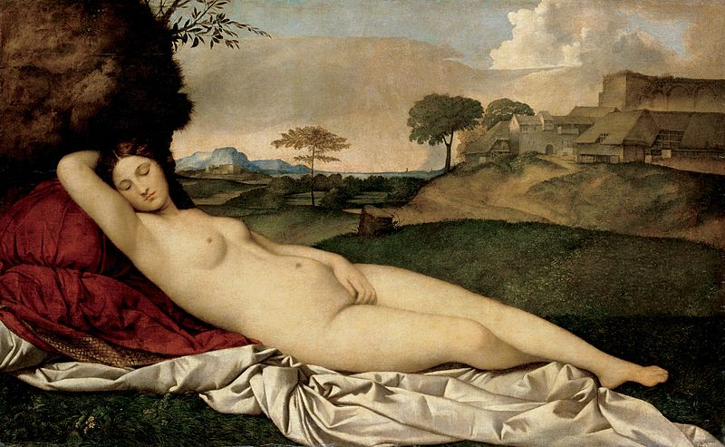
1

Slide 3
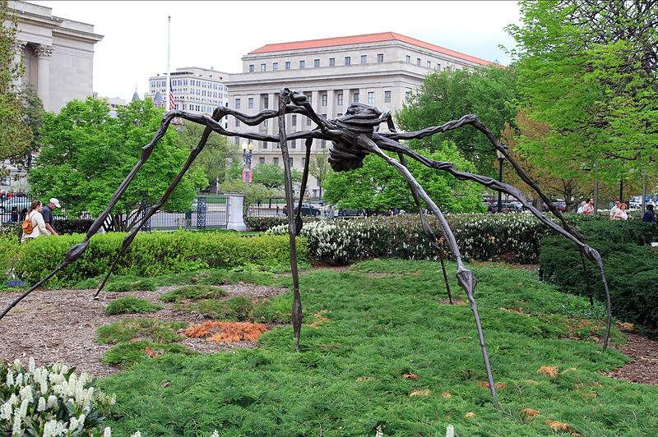
2

Slide 4
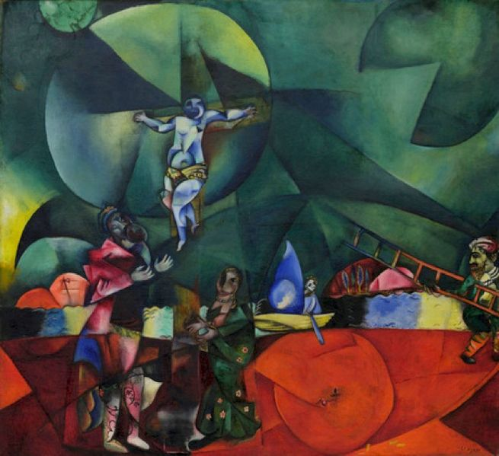
3

Slide 5
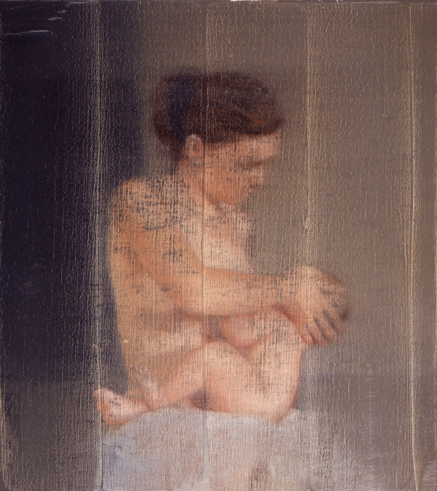
4

Slide 6
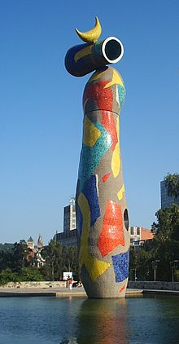
5

Slide 7
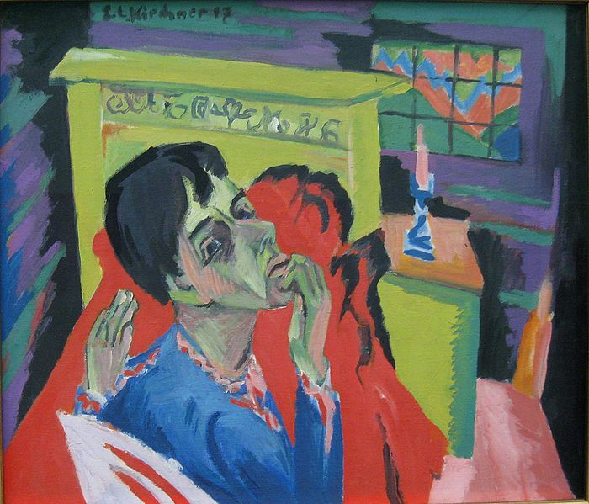
6

Slide 8
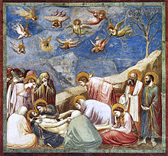
7

Slide 9
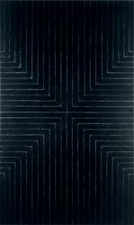
8

Slide 10
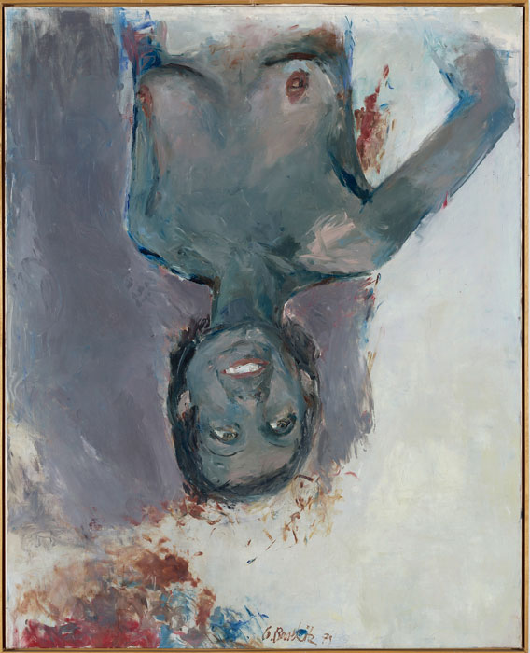
9

Slide 11
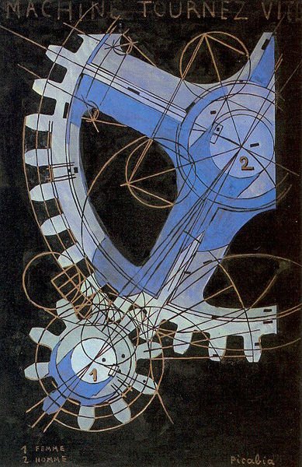
10

Slide 12
GiorgioneSleeping Venus (c. 1510)Gemäldegalerie Alte Meister, Dresden
Louise Bourgeois Spider in National Gallery of Art Sculpture Garden Washington, DC
Marc Chagall, 1912, Calvary (Golgotha), 174.6 x 192.4 cm, Museum of Modern Art, New York.
Gerhard Richter S. with Child 1995 46 cm x 41 cm Oil on canvas
Joan Miró Dona i Ocell, 1982, Barcelona, Spain
Ernst Ludwig Kirchner Selbstbildnis als Kranker, 1918, Pinakothek der Moderne, München
Giotto Lamentation (The Mourning of Christ), Cappella degli Scrovegni
Frank Stella, Die Fahne Hoch!, 1959,Whitney Museum of American Art
Georg Baselitz, Fingermalerei – Schwarze Elke, 1973, 162 x 130 cm, Private Collection
Francis Picabia Machine Turn Quickly, 1916-1918, tempera on paper, National Gallery of Art

